Slide 1
Artificial Intelligence in software Engineering
An expert Talk by :
Tarun Chhabra
13th December 2021

Slide 2
Contents
History of AI
AI in software engineering
Search Based Software Engineering (SBSE) concepts
Demo

Slide 3
History of AI
The idea that machines can be intelligent has provided a staple diet for science fiction
Turing - A. M. Turing, “Computing machinery and intelligence,” Mind, vol. 49, pp. 433–460, Jan. 01 1950.
J. McCarthy, “Programs with common sense,” in Proceedings of the Symposium on Mechanisation of Thought Processes, vol. 1. London: Her Majesty’s Stationery Office, 1958, pp. 77–84.
The field of AI research was founded at a workshop held on the campus of Dartmouth College, USA during the summer of 1956.
AI winter took over in the 70s and 80s with all the funding withdrawn by late 80s.
In the first decade of 21st Century AI was finally implemented by applying Machine Learning.

Slide 4
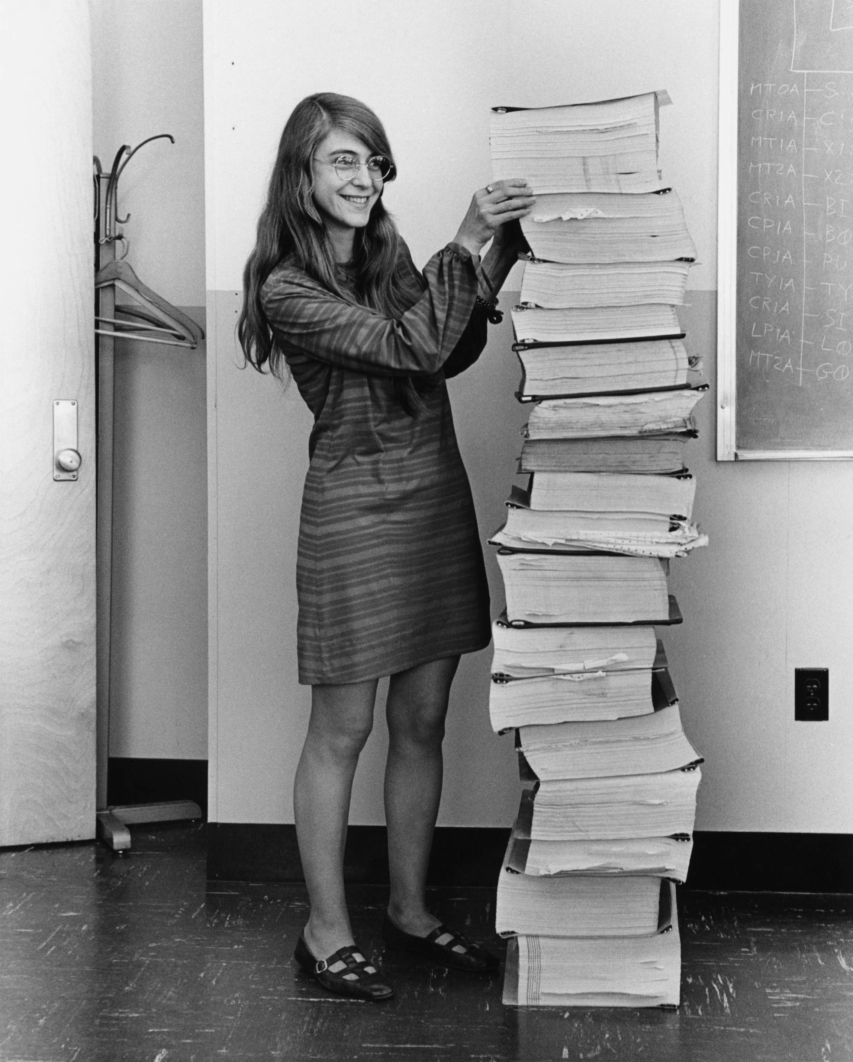
What came first ?
AI or Software Engineering ?
Artificial Intelligence is about making machines intelligent, while software engineering is the activity of defining, designing and deploying some of the most complex and challenging systems mankind has ever sought to engineer.

Slide 5
AI in software Engineering (AISE)
There are currently 3 broad areas of AI techniques in Software Engineering :
Computational search and optimization techniques (SBSE)
Fuzzy and probabilistic methods for reasoning in presence of uncertainty
Classification, learning and prediction

Slide 6
Fuzzy and probabilistic methods
In Fuzzy and probabilistic work, the aim is to apply to Software Engineering, AI techniques developed to handle real world problems which are, by their nature, fuzzy and probabilistic.
Examples :
Use of Bayesian probabilistic reasoning to model software reliability.
Analysis of users, inherently requiring an element of probability because of the stochastic nature of human behaviour.

Slide 7
Classification, learning and prediction
In classification, learning and prediction work there has been great interest in modelling and predicting software costs as part of project planning.
Software project prediction
Software defect prediction
Machine learning - T. Menzies, “Practical machine learning for software engineering and knowledge engineering,” in Handbook of Software Engineering and Knowledge Engineering. World-Scientific, December 2001, available from http://menzies.us/pdf/00ml.pdf.

Slide 8
Search Based Software Engineering
We will be talking more in depth on this topic !
Search Based Software Engineering (SBSE) work, the goal is to re-formulate software engineering problems as optimization problems that can then be attacked with computational search
This has proved to be a widely applicable and successful approach, with applications from requirements and design to maintenance and testing.

Slide 9
SBSE – The next BIG thing after BIG DATA
After "data collection" comes "model construction" so the next big thing after big data will be "big modeling”.
Convert any problem into a mathematical equation problem = Your model
Then apply search to find (or try) to find the most optimum solution.
Search : Un-ordered search
Optimization techniques :
Simulated Annealing
MAXWALKSAT
Particle Swarm Optimization
And many more …

Slide 10
Ordered Vs Unordered Search
Ordered-search; e.g. the tree and graph searchers discussed below. In this kind of search, the solutions spreads out in a wave over over some solution space.
Unordered-search where a partial solution is quickly (randomly) generated, then maybe fiddled with. A common unordered search method is to generate a number of slots, each with random values as done in PSO or simulated annealing or MAXWALKSAT.
Unordered search is useful for problems where ordering does not matter. For example, if a simulator accepts N inputs, then an unordered search might supply M ≤ N inputs and the rest are filled in at random.

Slide 11
Add some Stochastic search to it
Unordered search is often explored by some kind of stochastic search. Rather than struggle with lots of tricky decisions,
Exploit speed of modern CPUs, CPU farms.
Try lots of possibilities, very quickly
Stochastic search: randomly fiddle with current solution
Local search: . replace random stabs with a little tinkering

Slide 12
Decades of work
1950s: Simulated annealling
1960s: Genetic algorithms
1991: ISSAMP
1992: WALKSAT
1997: Differential evolution
2000+: Multi-objective evolutionary algorithms

Slide 13
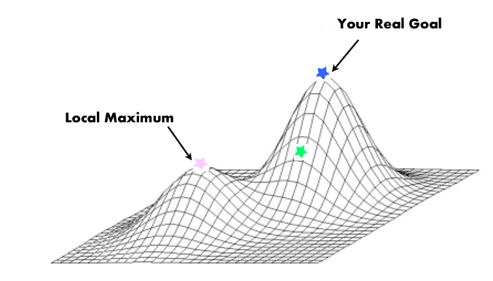
Simulated Annealing
From: S. Kirkpatrick and C. D. Gelatt and M. P. Vecchi Optimization by Simulated Annealing, Science, Number 4598, 13 May 1983, volume 220, 4598, pages 671680,1983.
If we just do a greedy search (i.e. find the next best nearby thing and jump to it) then that search can get trapped and tricked by ideas that are locally promising but not globally optimal
A generates new solutions by randomly perturbing (a.k.a. “mutating”) some part of an old solution. New replaces old if
It scores higher; or (b) It reaches some probability set by a “temperature” constant.

Slide 14
SA - Algorithm

Slide 15
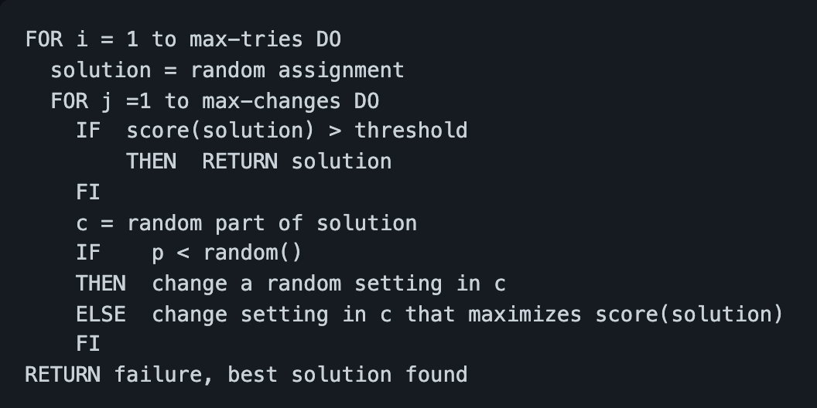
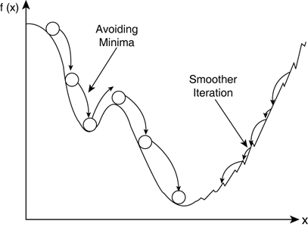
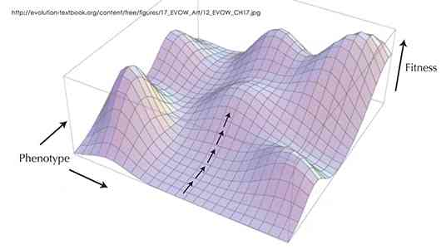
Maxwalksat
In terms of landscapes, it is like:
Jump all around the hills
Sometimes, sitting still while rolling marbles left and right
Then taking one step along the direction where the marbles roll the furthest.
Go to 1.

Slide 16
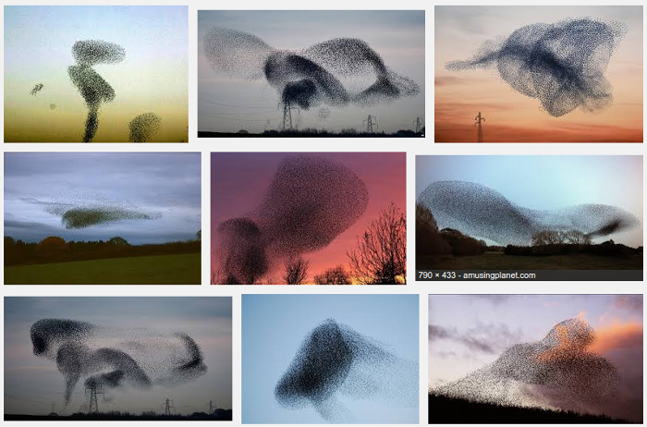
Particle SWARM optimization
See the fantastic videos of starling murmurations.

Slide 17
Why and how ?
So, how can flocks form into fantastic patterns?
Firstly, they flock for survival. In a flock, every bird strives to avoid the edge where adept predators can sometimes snatch a victim. And starling flocks can be very big (10,000 to 100,000s). Which means that such flocks have emergent properties...
Secondly, the patterns in starling flocks come from the mathematics of close flocking
Rule1: Each starling does whatever its neighbor is doing.
Rule2: A starling must maintain a certain pattern of light and dark in its field of vision.
If you think of a murmuration as a giant cloud of starlings, each bird won't want to move to the densest, darkest part--otherwise, looking out from within the cloud would become impossible.
Similarly, birds won't want to go to the lightest bits, characterized by sky, or they'll detach from the flock entirely.
Rule3: add in some stochastic jiggle.

Slide 18
What is PSO ?
In computer science, particle swarm optimization (PSO) is a computational method that optimizes a problem by iteratively trying to improve a candidate solution with regard to a given measure of quality.
PSO optimizes a problem by having a population of candidate solutions, here dubbed particles, and moving these particles around in the search-space according to simple mathematical formulae over the particle's position and velocity.
Each particle's movement is influenced by its local best known position but, is also guided toward the best known positions in the search-space, which are updated as better positions are found by other particles.
However, metaheuristics such as PSO do not guarantee an optimal solution is ever found.

Slide 19
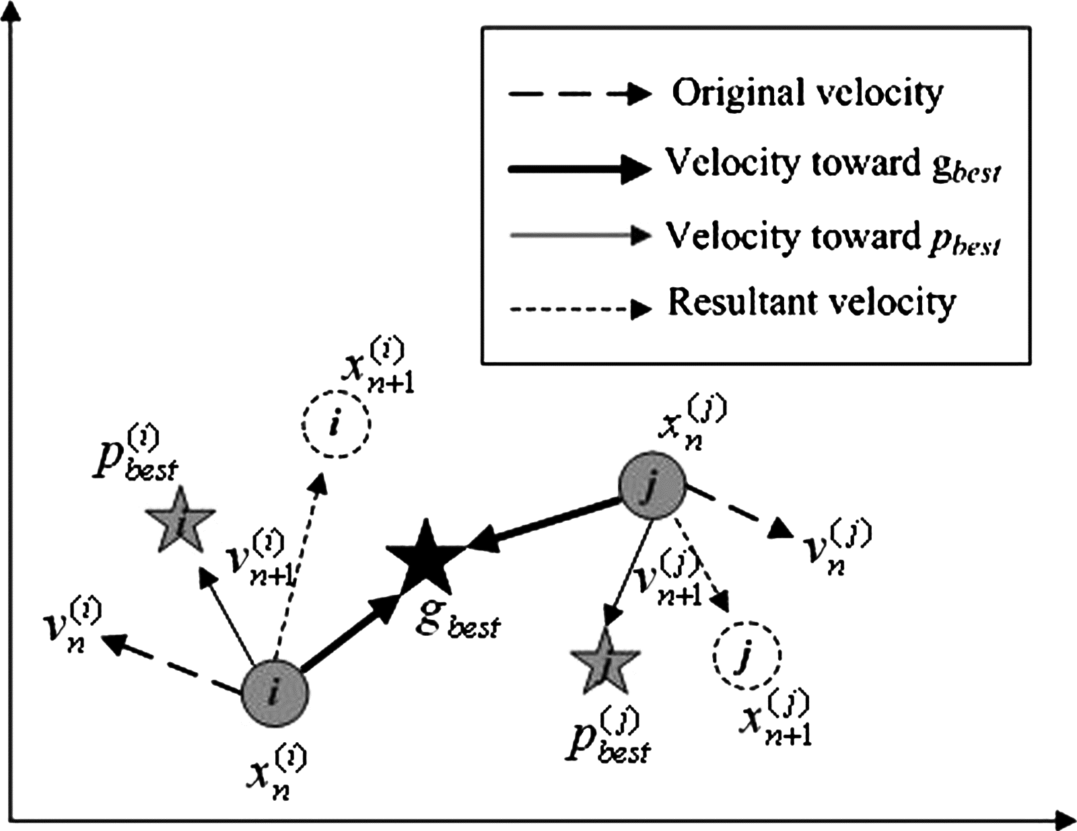
PSO : Algorithm and Visualize

Slide 20
Let’s see some code !
https://github.com/tarunchhabra26/AISE2021

Slide 21
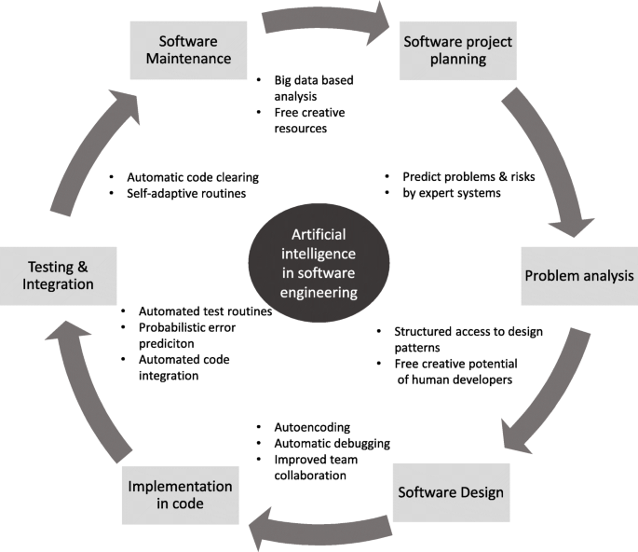
AI in SE – Full SDLC

Slide 22
Example project
Cloud infrastructure optimization : https://github.com/tarunchhabra26/fss16dst/blob/master/project/report/REPORT.md

Slide 23



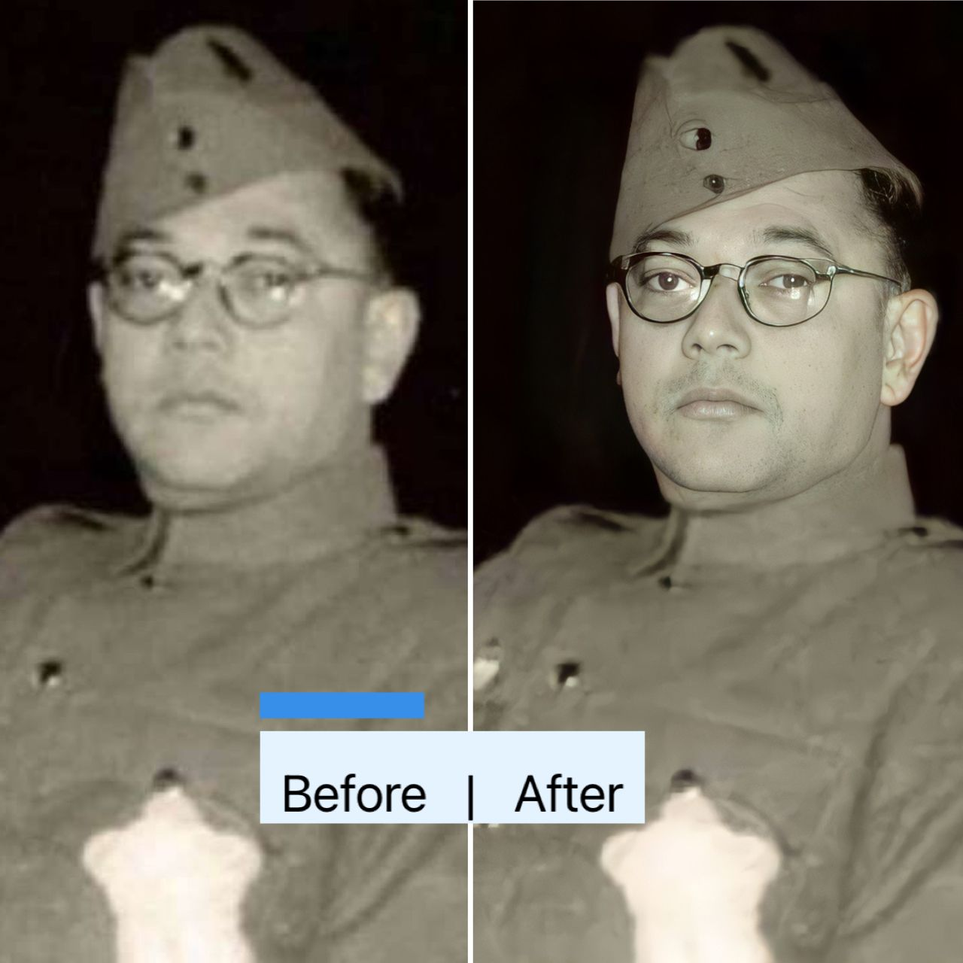
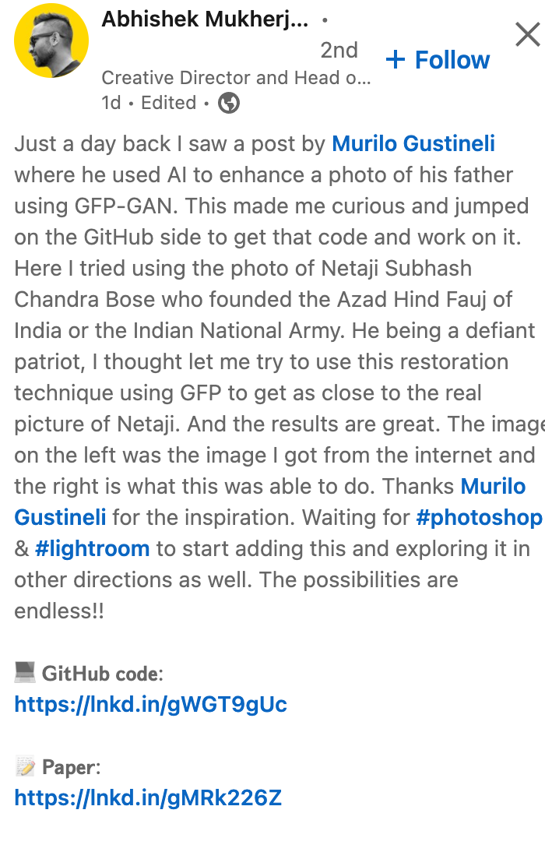
Future of AI is limitless
NVIDIA StyleGAN 2
https://github.com/TencentARC/GFPGAN
https://arxiv.org/pdf/2101.04061.pdf

Slide 24
Acknowledgements
Dr. Tim Menzies
Dr. Arpana Prasad
Dr. V Asha
Department of MCA, New Horizon College of Engineering

